Slide 1
CUSTOM LINUX SHELL
By bhavin patel

Slide 2
background
The purpose of this project was to create a Custom Linux Shell that was a more complete shell than shittyshell. I wanted to dive deeper into the linux OS in order to understand how commands and programs are executed so I thought building on what I learned with shittyshell would be a good start.
I will highlight the functionalities of the custom-designed Linux shell which includes some of the commands that were supported.

Slide 3
FEATURES
Some of the commonly used commands in Linux that was implemented in the custom shell:
List
Change mode
Show Environment
Search Binary Location
Change Directory
Notes:
The commonly used commands in Linux that are implemented in the custom shell are as follows:
List: List and generate statistics for files so that the user can view the statistics of the file to check for the available functions that can be performed on the file.
Change mode: Change file mode to provide the list of functions on the file. For the future preferences of the file.
Show environment: Show the environment variable of PATH in which the user binaries are stored. Then it will append the path variable value to the command so that it can be executed.
Search binary location: It will search for the command that the user typed in the /usr/bin folder of the environment variable to execute the given command.
Change directory: Change the current directory of the Linux to the provided directory by the user so that future functions would be conducted in the changed current directory.

Slide 4
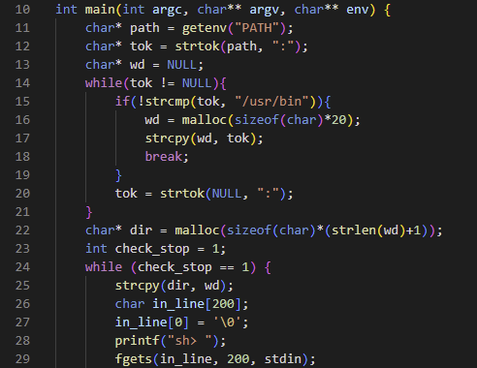
IMPLEMENTATION
Notes:
In this project, a custom Linux shell was implemented that supports the features of the bash shell of the Linux Operating System. The shell includes support for keeping track of the environment variable so that the user can search for the specified commands in the user binary folder and then execute the user-typed command by searching in the binary files directory for the user. To implement the custom shell, the first thing that was needed was the environment variables so I used the char** env array provided in the main function of the program.
The environment variables array contains all the environment variables of the user who is executing the shell. After getting the environment variables for the user who is executing the shell, the shell searches for the PATH variable to get the PATH environment values from the environment strings. After successfully getting the PATH variable, it searches for the /usr/bin directory and then store it in a variable to append the command with it later.

Slide 5
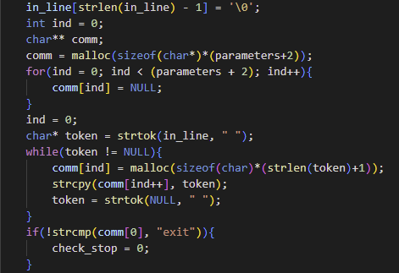
IMPLEMENTATION
Notes:
After getting the environment variable the program takes input from the user. The program will continue to ask the user for input of command till the user enters “exit”. Upon entering the “exit” command, the program will end the execution and return control to the user.
After getting the command as input from the user, the command is tokenized so that the command and the arguments can be separated and stored in the command array to be passed onto the exec function to execute the given command. After tokenizing the command, the PATH environment variable value is appended to the command to get the complete path of the command that the user wants to execute.

Slide 6
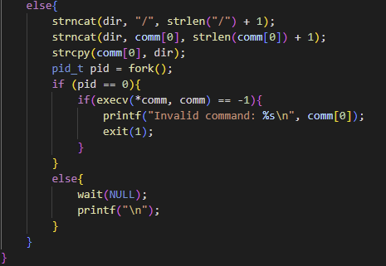
IMPLEMENTATION
Notes:
After appending the environment variable to the command, the program creates a child process to call the exec function to execute the command. After creating the child process the command array is passed to the exec function along with the complete arguments that are provided with the command to search for the command in the user binary files location to get a binary executable of the command. Then after searching for the command in the user binary file location, the exec function runs the command along with the arguments provided.
While the execution of the exec function, the command is invalid, then it shows the invalid command error on the screen so that the user may know that the command is not correct and the binary of the command cannot be found in the user binary file location. If the command execution is successful, the exec function shows the output of the command on the standard output and returns it to the parent process. And in the same way, the complete cycle of the shell execution continues till the user enters the exit command.

Slide 7
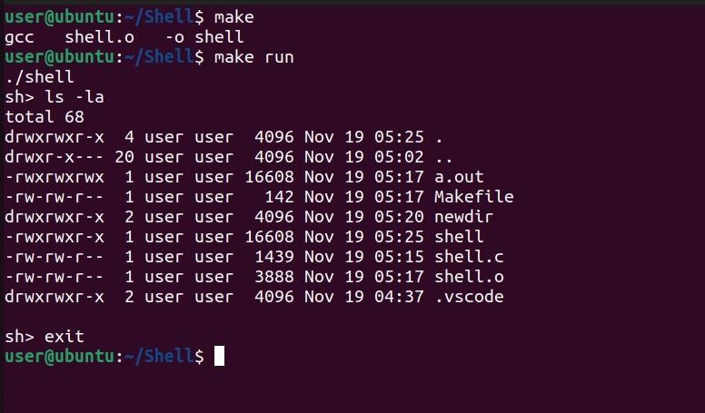
Results and analysis
LIST STATISTICS => List and generate statistics for files so that the user can view the statistics of the file to check for the available functions that can be performed on the file
Notes:
I encountered a lot of issues with segmentation faults and trying to get the program to compile which was eventually solved by a lot of tinkering and reading through troubleshooting forums, The features proposed to be implemented in the project were implemented successfully and the desired output was achieved. A makefile for the program was also created to easily compile and execute the shell. The makefile compiles the program using the GNU compiler collection command and then stores the compiled program in an object file. After that, it links the object file with the required libraries and generated a binary executable file using the -o flag.

Slide 8
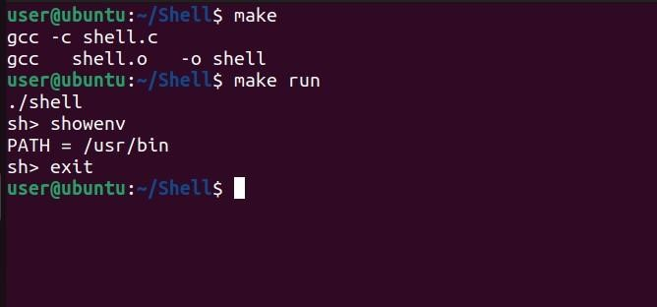
Results and analysis
SHOW ENVIRONMENT
Show the environment variable of PATH in which the user binaries are stored. Then it will append the path variable value to the command so that it can be executed.

Slide 9
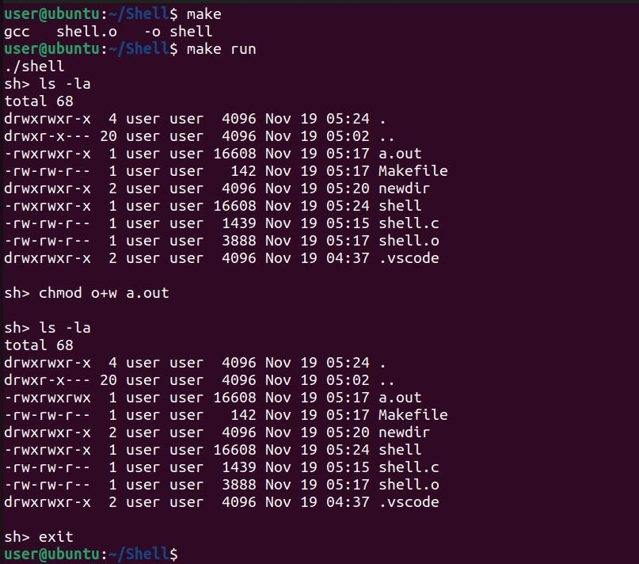
Results and analysis
CHANGE MODE
Change file mode to provide the list of functions on the file. For the future preferences of the file.

Slide 10
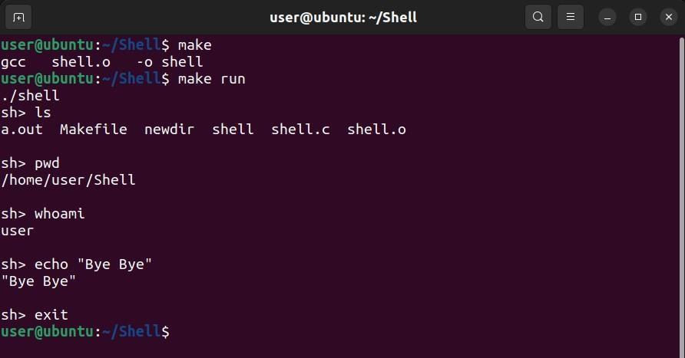
Results and analysis
SEARCH BINARY LOCATION
It will search for the command that the user typed in the /usr/bin folder of the environment variable to execute the given command.

Slide 11
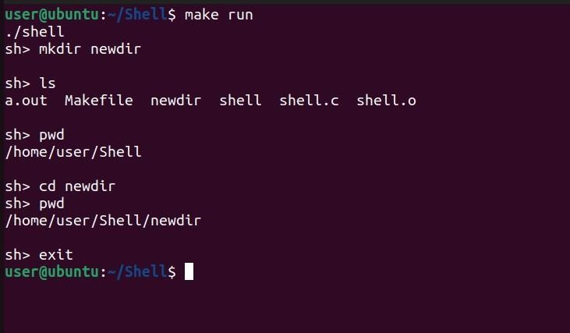
Results and analysis
CHANGE DIRECTORY
Change the current directory of the Linux to the provided directory by the user so that future functions can be conducted in the changed current directory.

Slide 12
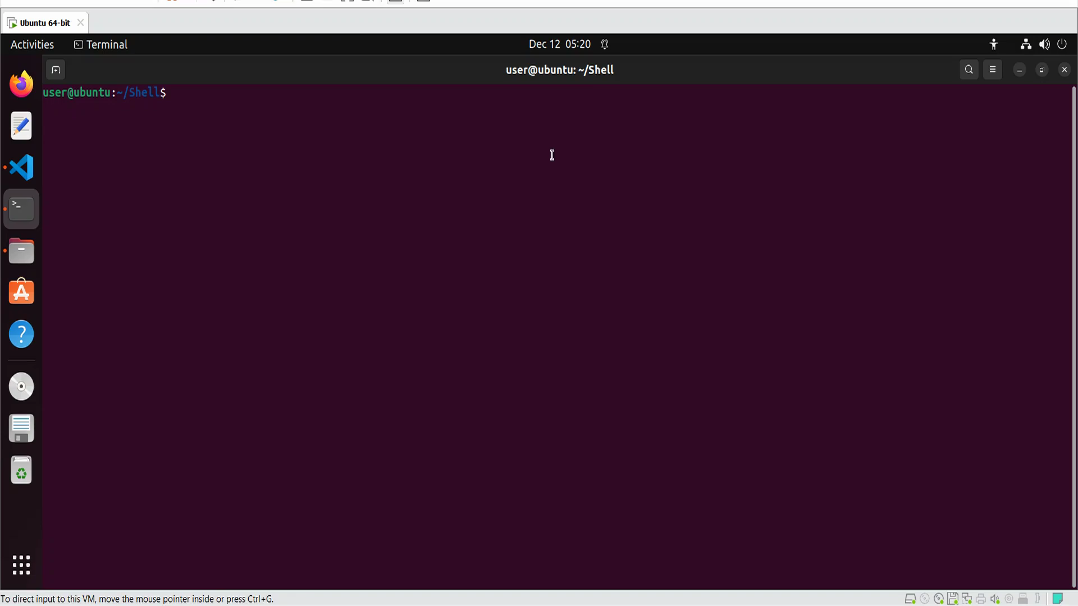
demo

Slide 13
THANK YOU !

